Slide 1




MLBD MRes practical
Introduction to neural networks
Single neuron classifier
Colour swatch
Patrick Dunne
Material this week developed by Jarvist Moore-Frost
Styles + Sizes: (by Golden Ratio)
36 for large headline, Montserrat
22 for big text / small headlines, Questrial (Futura like)
14 for small text, Questrial
9 (8.5) for smaller text, Questrial
36 Montserrat - SemiBold
22 Questrial big text // 22 Montserrat - SemiBold (small headings)
14 for small text, Questrial
9 (8.5) for smaller text, Questrial
Colour swatch

Slide 2
Intended Learning Outcomes
Demonstrate how artificial neural networks are built, by constructing a single neuron classifier from scratch.
Summarise the biological origin of artificial neural networks. (Slides)
Prepare a binary classifier from a single neural network. (Jupyter)
Generalise the 'by hand' approach into functions.
Compare with a logistical regression approach to the same data.

Slide 3
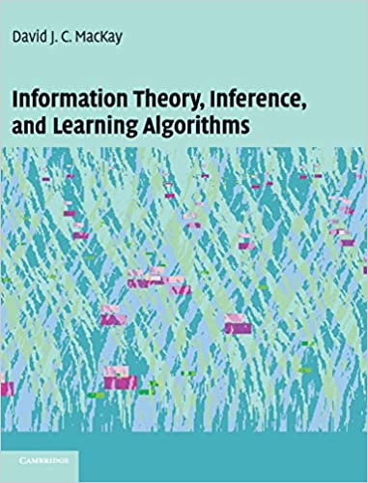
Recommended reading
David MacKay, Information Theory, Inference and Learning Algorithms (ITILA), 2003, Chapters 38–42.
Freely available online!
A physicists perspective on ML.
http://www.inference.org.uk/mackay/itila/book.html
These slides and classworks follow some of the structure of Chapter 38 & 39.

Slide 4
Practicalities
Best guide for reproducible research / package managers / guide to running online meetings etc.:
https://the-turing-way.netlify.app/welcome
Alan Turing institute is London base for AI research, but this guide has taken on a life of its own!
Much better reference than random googling!
Beware that a lot of Blog posts on ML are written by students / self-taught people trying to 'break into' ML.
Materials for the next 4 weeks:
⇒ https://github.com/ICMResMLBDinPhysicalSciences/2022-PracticalSessions

Slide 5

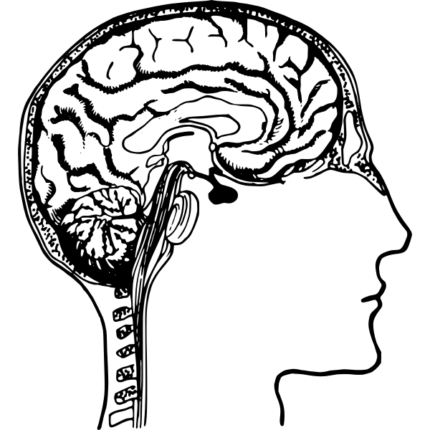
Biological inspiration
"Anatomy and Physiology" by the US National Cancer Institute's Surveillance, Epidemiology and End Results (SEER) Program .
Neurons have multiple inputs / outputs
Relatively (!) simple functional relationship
86 billion neurons ⇒ human brain
0.1 million neurons ⇒ fruit fly Drosophila (fully imaged 2020)

Slide 6
Biological inspiration: memory

Slide 7

Biological inspiration: memory

Slide 8
Associative, extrapolative, memory
Vs. address based memory in a library / computer.

Slide 9


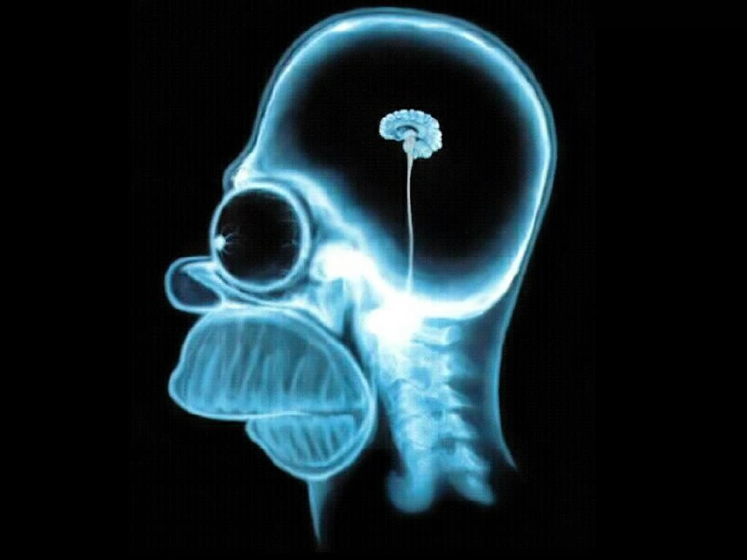



Spontaneous recall

Slide 10
Human perception: fault tolerant
Yuo cna porbalby raed tihs esaliy desptie teh msispeillgns.

Slide 11
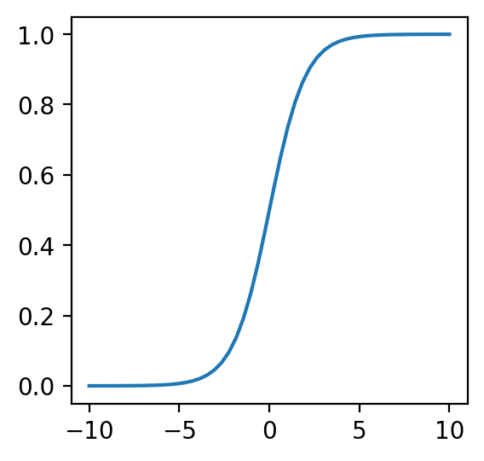
Biology → code
Abstract (and vastly simplify!) neuron behaviour to a sigmoid / tanh

Slide 12
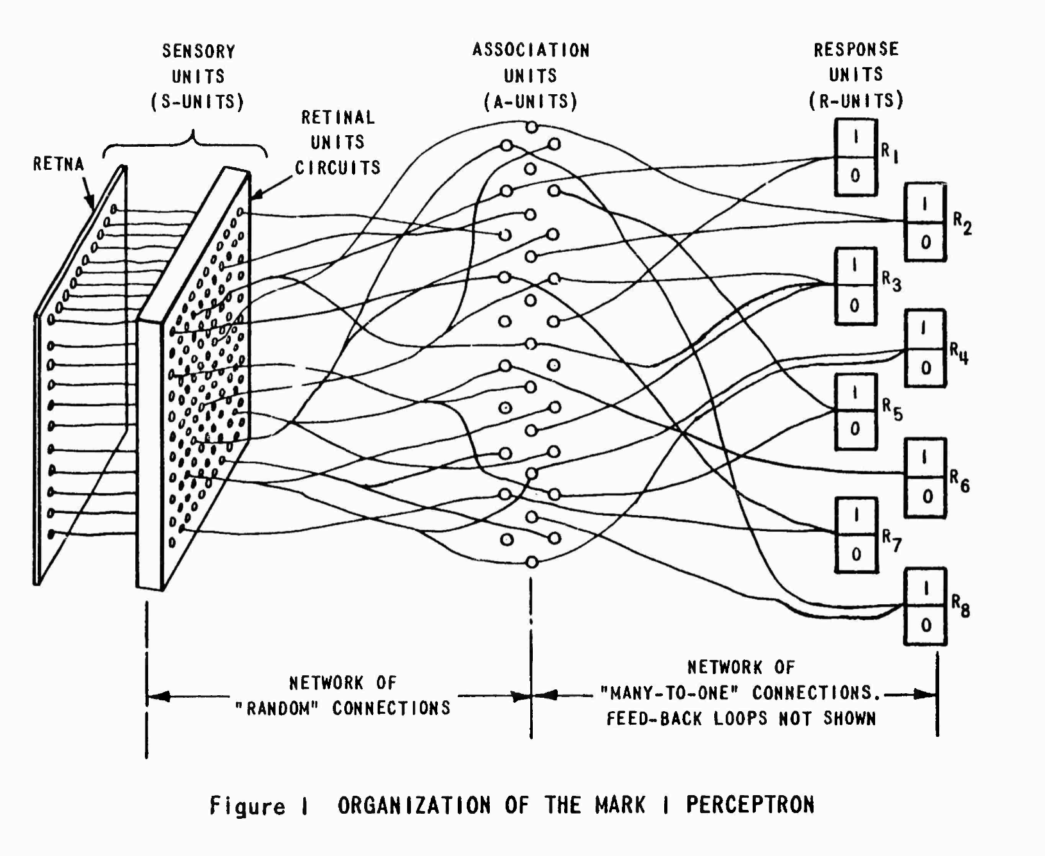
The Mark 1 Perceptron (1957>)
20x20
CdS photocells

Slide 13
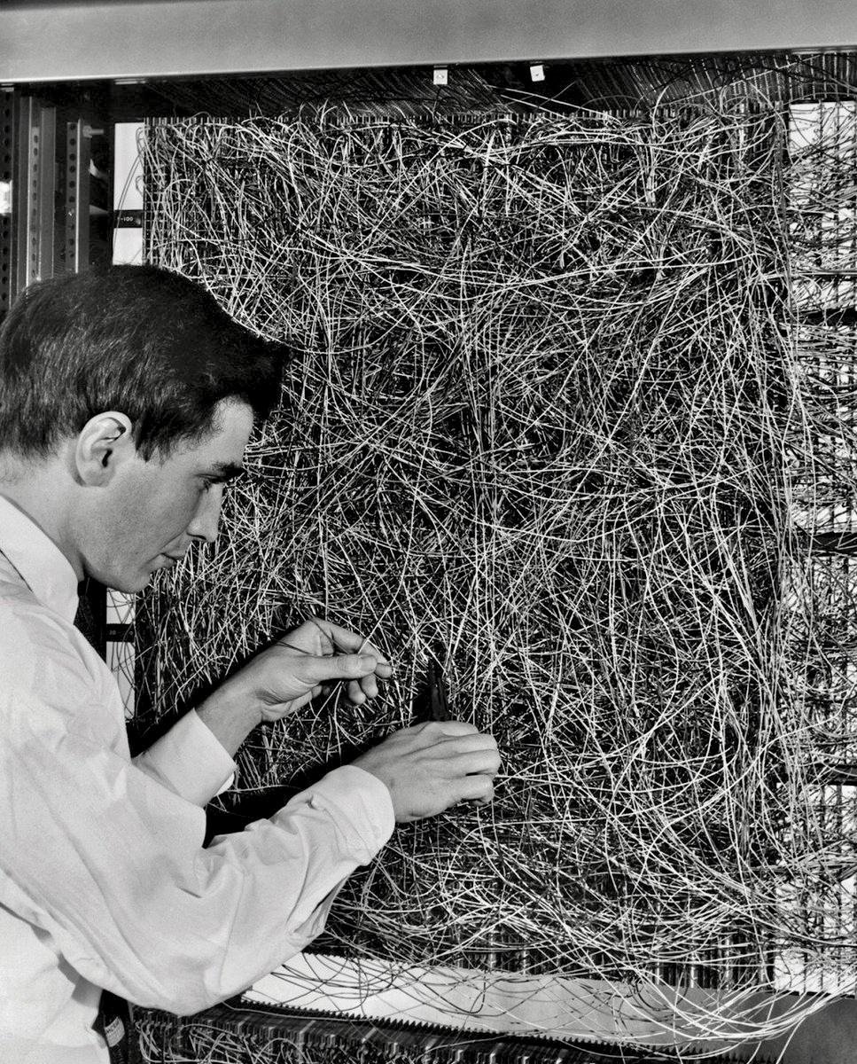
Frank Rosenblatt, with the 'feature selector' input patch

Slide 14
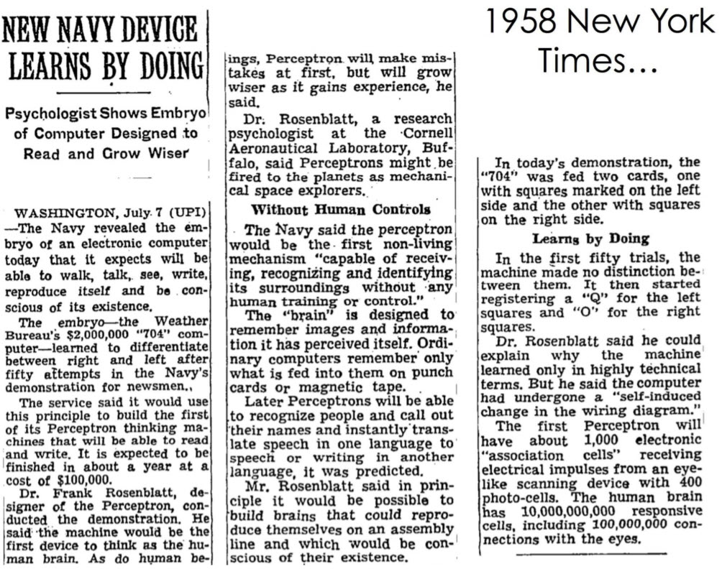
New York Times, July 8th 1958

Slide 15
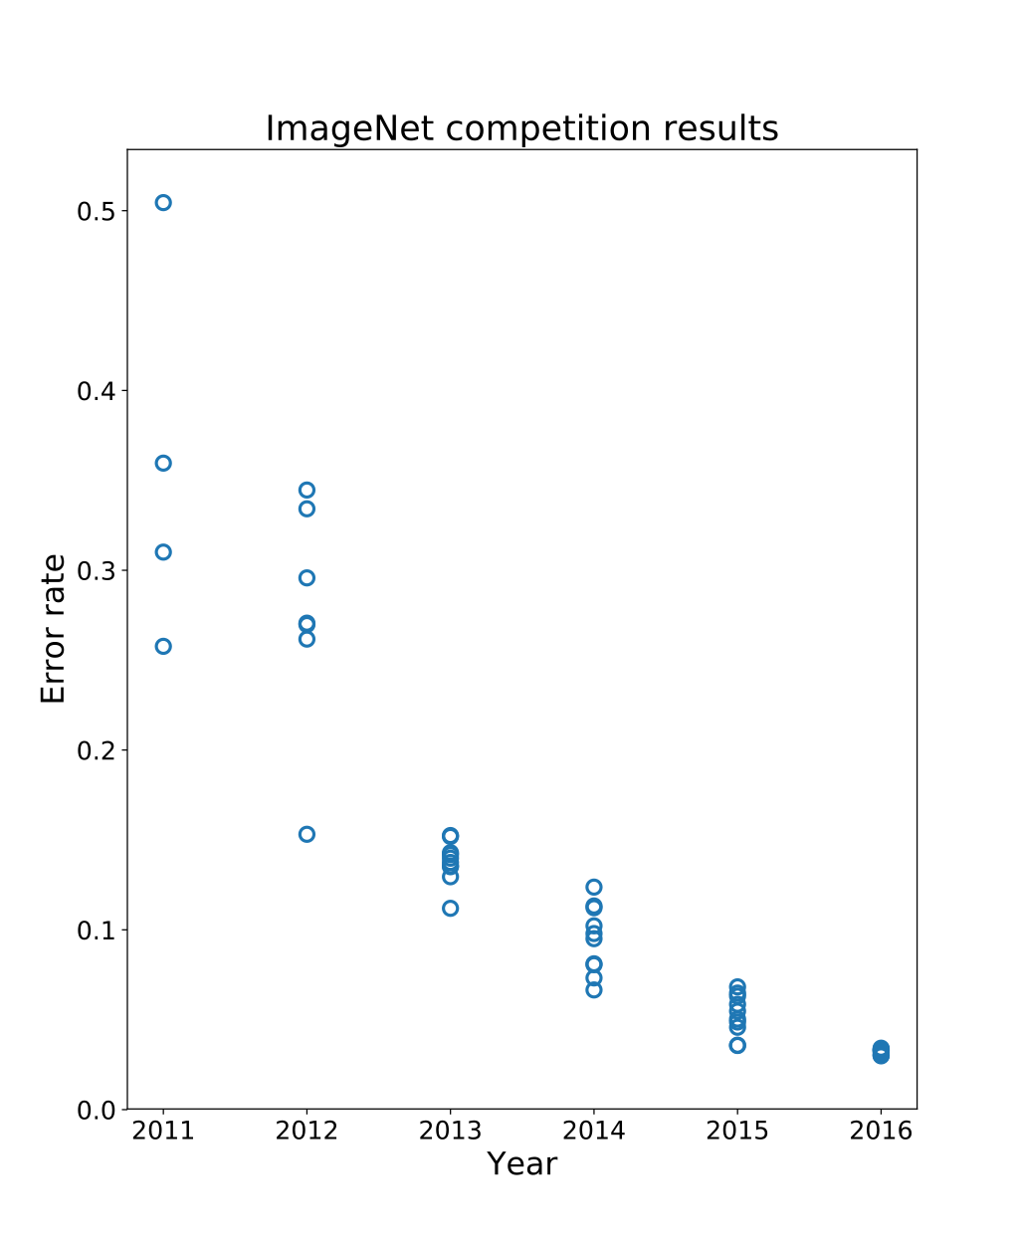

AlexNet,
A deep convolutional neural network,
16% error
In 2012 neural networks mostly solved computer vision
(Imagenet = 14 million annotated images.)

Slide 16

MNIST - a relatively simple, 'toy', dataset.

Slide 17
Practical
Notebook: week08-JMF-IntroToNNs/NeuralNetworks-SingleNeuronAsBinaryClassifier
Add missing code:
Sigmoid activation function
Neuron function
Training loop
You can now train a model & visualise the decision boundary!
Document how the training performs, with different training rates ('eta') and weight decay ('alpha)
Compare training with a simple linear classifier
How does the neuron fair on the more difficult Gaussian dataset?
Advanced concepts
Change the activation function. (Think about the gradients.)
Often neural networks have an additional 'bias' input. Add this to your code.
Batch training - currently all data is used to build the single gradient.
What happens if you try and use the method for regression (against a function)?
Can you improve the regression performance by adding extra neurons side-by-side, each fitting a different part of the function?
Suggested homework / self-study
David MacKay, Information Theory, Inference and Learning Algorithms (ITILA), 2003, Chapters 38–42.
PyTorch '60 minute Blitz' https://pytorch.org/tutorials/beginner/deep_learning_60min_blitz.html

Slide 18
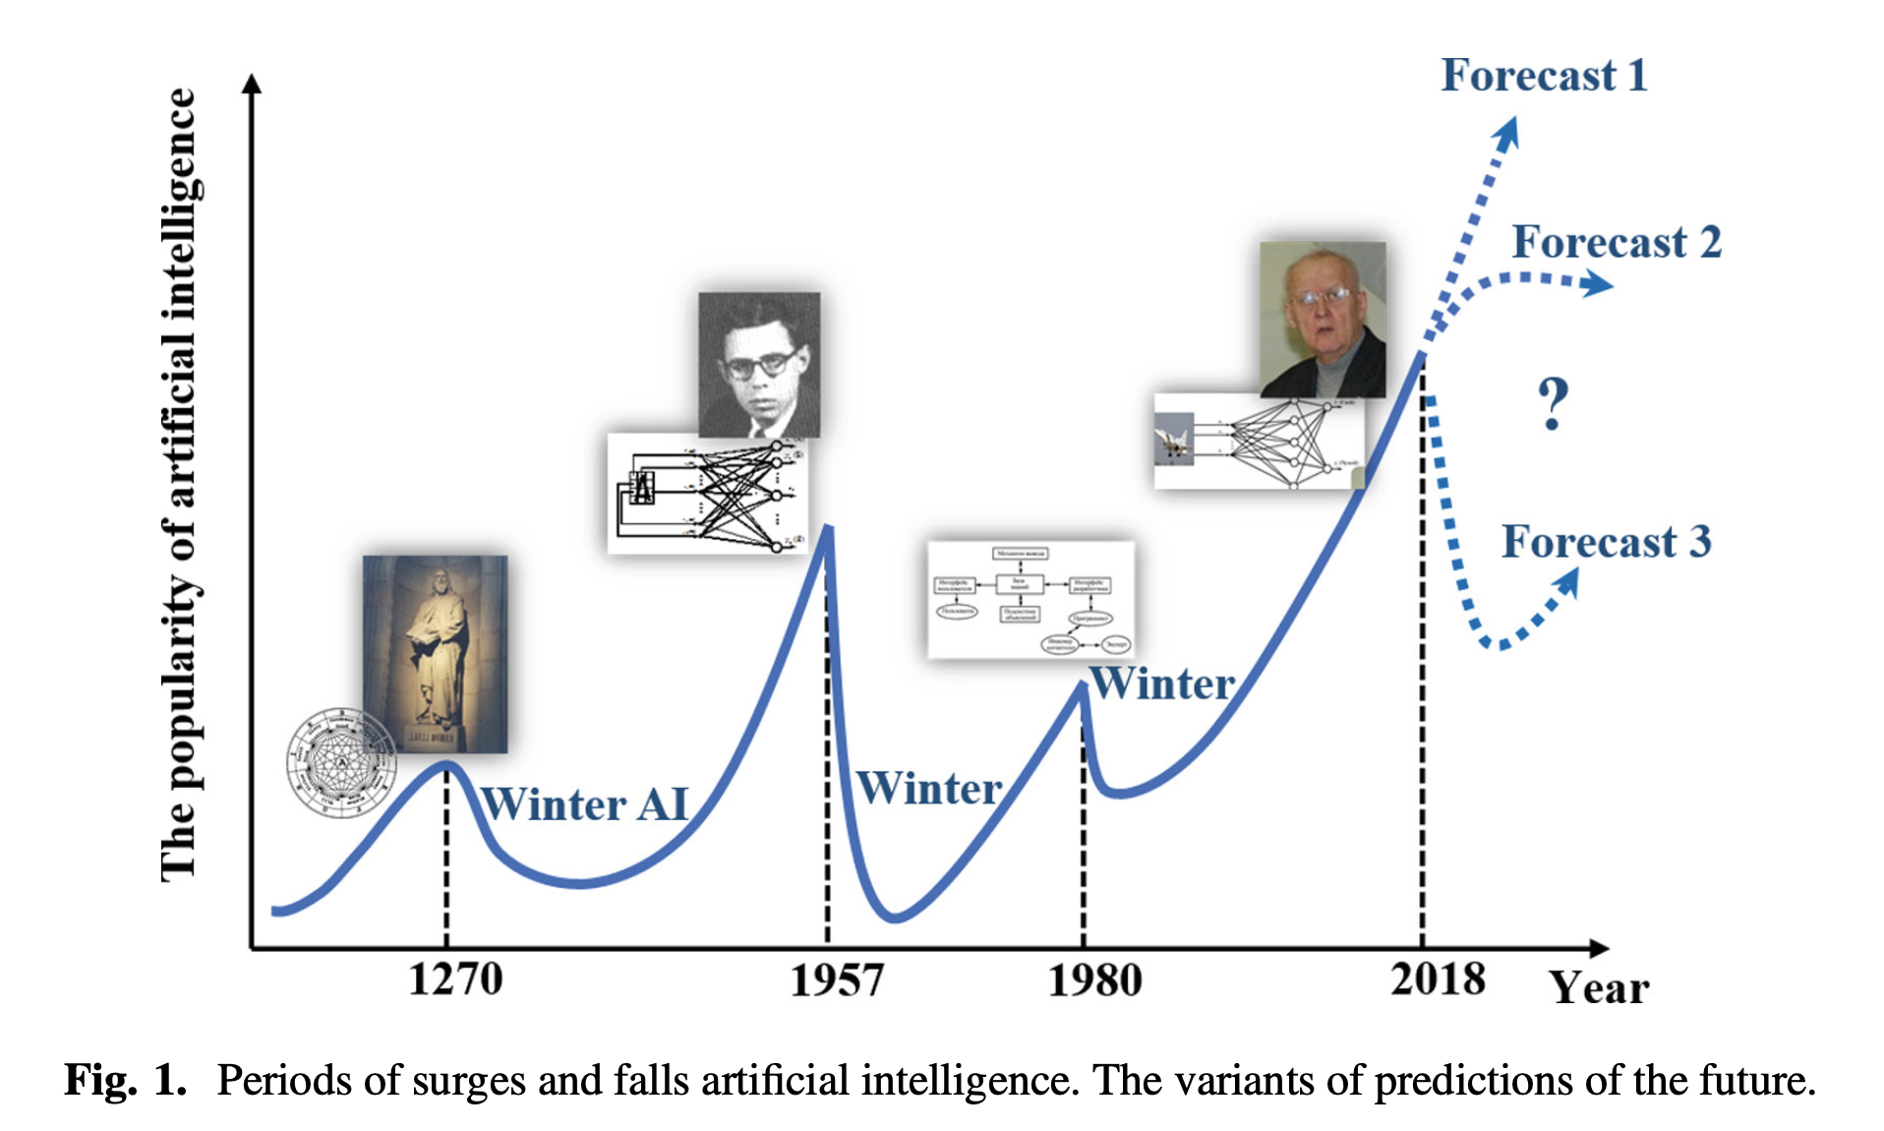
Yasnitsky, L. N. (2019). Whether Be New “Winter” of Artificial Intelligence? Lecture Notes in Networks and Systems, 13–17. doi:10.1007/978-3-030-22493-6_2
Paper argues that 'Forecast 3' & a new winter is inevitable!

